Slide 1
願祢的國降臨
Thy Kingdom Come
小羊詩歌 Lamb Music

Slide 2
願祢的國降臨 願祢的旨意行在地上 如同行在天上 (2X)
May Your kingdom come May Your will be done on earth as it is in heaven

Slide 3
因為國度，權柄， 榮耀全是祢的 (3X) 直到永遠，直到永遠!
For Yours is the kingdom and the power and the glory
Forever and ever!

Slide 4
願祢的國降臨 願祢的旨意行在地上 如同行在天上 (2X)
May Your kingdom come May Your will be done on earth as it is in heaven

Slide 5
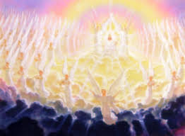
願祢的國 降臨
Thy Kingdom Come

Slide 6
願祢的國降臨 願祢的旨意行在地上 如同行在天上 (2X)
May Your kingdom come May Your will be done on earth as it is in heaven

Slide 7
因為國度，權柄， 榮耀全是祢的 (3X) 直到永遠，直到永遠!
For Yours is the kingdom and the power and the glory
Forever and ever!

Slide 8
願祢的國降臨 願祢的旨意行在地上 如同行在天上 (2X)
May Your kingdom come May Your will be done on earth as it is in heaven

Slide 9
願祢的國降臨 願祢的旨意行在我身上 如同行在天上 如同行在天上
May Your kingdom come May Your will be done on me as it is in heaven

